Slide 1


FINAL YEAR PROJECT Presentation: AUTOMATED SCRIPTS FOR TESTING VERILOG DESIGNS WITH IVERILOG
By: Ng Jia Hao Gary (U1221594E)
Supervisor: Assistant Professor Suhaib A Fahmy
Examiner: Dr Owen Noel Newton Femando

Slide 2

Agenda of Presentation
Background of the Project
Introduction
What I Have Done
Automated Testbench Creation Script
Integration with the iVerilog Tools
Future Work Recommendations
Challenges and Learning Points
Conclusion
Acknowledgement
QnA

Slide 3

Background of the project
Tedious process to write testbench to test the verilog design
Require a very clear understanding of the design specifications
Lack of the required knowledge

Slide 4
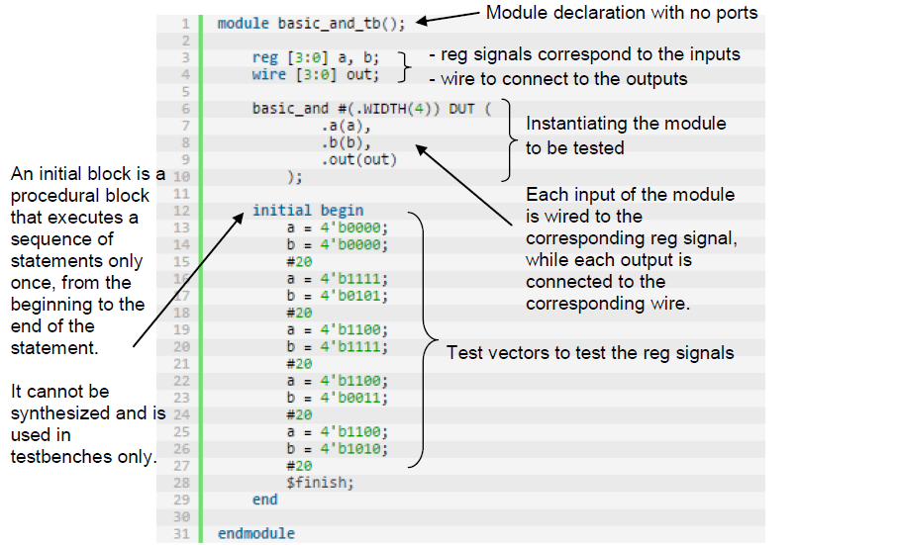
Background of the project
What is a testbench?

Slide 5
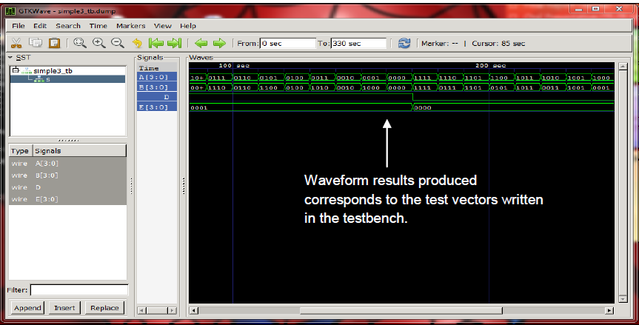
Background of the project
Producing a waveform output from a testbench

Slide 6

Project objective
Use the iVerilog tool to develop automated scripts
To test the verilog designs
Provides a basis to learn the verilog hardware description language better
Using the verilog structures taught in both CE1005 and CE2003 modules

Slide 7

Project Scope
The project is divided into 3 different phases:
Phase 1: Preparation Phase
Exploring the various functionalities of the iVerilog tool
Documenting the entire installation/configuration process
Phase 2: Design & Implementation Phase
Extracting of variables from a given input verilog file
Generating of test vectors and producing of a testbench file
Developing a script to integrate with iVerilog tool

Slide 8


Project Scope
The project is divided into 3 different phases:
Phase 3: Testing Phase
Ensuring the scripts implemented are robust and error free
Ensuring Cross-platform compatibility
Scripts should be able to execute in both Linux and Windows OS

Slide 9
Resources used
Name of Resources | Version
Operating System(s)
Windows 7 | 64-bits with Service Pack 1
Ubuntu OS | 14.0.1
Software(s)
Icarus Verilog (iVerilog) | 0.9.7
GTKWAVE Analyzer | 3.3.57
Python IDLE | 3.4.1

Slide 10

Why was python used?
High-level feature rich programming language
Emphasizes greatly on
Code readability
Expressing of concepts using few lines of coding
Cross-platform compatible
Both Linux and Windows OS

Slide 11
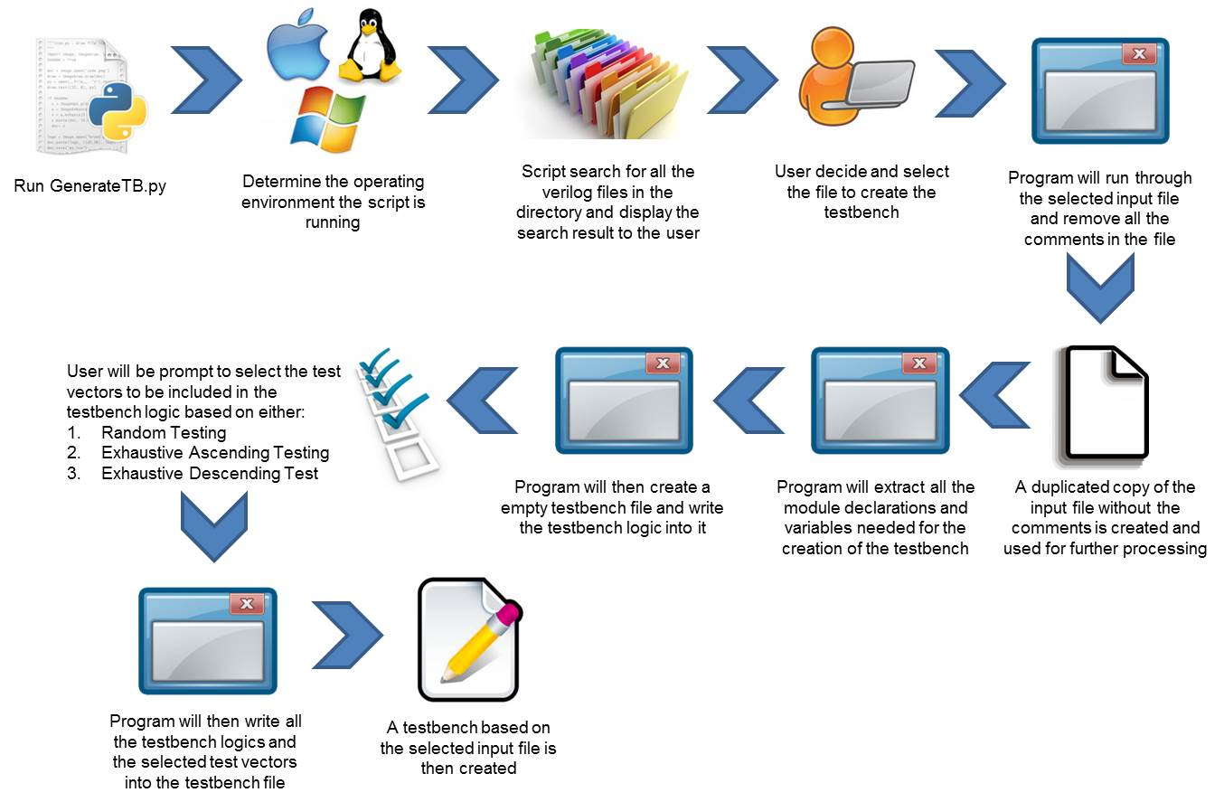
Automated testbench creation Script
Overview of the design flow

Slide 12
Automated testbench creation Script
Overview of the design flow

Slide 13
Test scenarios conducted
Test scenarios comprise of the following factors:
Ability to detect the verilog files in a directory correctly
Ability to execute in both Ubuntu and Windows operating environment
Ability to extract the ports declaration, module declaration correctly
Ability to implement the test vectors correctly
Ability to generate the testbench successfully
Ability to aid undergraduates in learning the Verilog hardware language
Testbench created should be easily to understand
Testbench created should be similar to the syntax taught in lectures

Slide 14
Test scenarios and results
Evaluation Factors | Description | Outcome
1. Cross-platform compatibility | The script implemented should be able to identify the operating environment the script is executing in and execute the segment of the written program code correctly.
2. Listing of verilog files found | The script implemented should be able to correctly list out all the verilog files found within the specified directory.
3. User input validation | If a user enters an index value which exceed the total index value of the listed files found, the script should be able to display an error message to the user and prompt the user to re-enter the index value again.

Slide 15
Test scenarios and results
Evaluation Factors | Description | Outcome
4. Checking if the input verilog file is supported by the script | The script should be able to determine if the module declaration of the input verilog file is supported by the script.
5. Removing of the comments in the verilog file | The script should be able to remove all the comments written in the verilog file to prepare for the information extraction to create the testbench file.
6. Extracting of all the necessary information required to create a testbench | The script should be able to extract the following information from the given file: 1. Module declaration 2. Ports declaration 3. Module name

Slide 16
Test scenarios and results
Evaluation Factors | Description | Outcome
7. Convert the ports obtained correctly | The script should be able to change all the input ports to reg signals and all the output ports to wires correctly.
8. Obtaining the correct bit-width value of the port correctly | The script should be able to obtain the correct bit-width size values of the respective ports correctly based on the port MSB and LSB value.
9. Creating test vectors for testing the source design | The script should be able to generate the respective test vectors correctly that will be written into the testbench file to verify the correctness of the source design implemented.

Slide 17
Test scenarios and results
Evaluation Factors | Description | Outcome
10. Producing a testbench file at the end of the execution | The script should be able to successfully generate the testbench output file with all the necessary input parameters and test vectors.
11. Syntax of testbench created | The syntax of the testbench created should be similar to the testbench taught in CE1005 and CE2003 lectures.
12. Readability of the testbench created | The testbench created should be easy to understand, well-structured and organised.

Slide 18
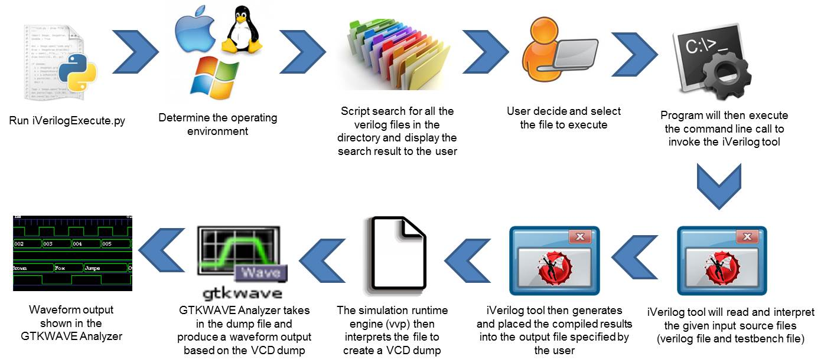
Integration with iVerilog tool
Overview of the design flow

Slide 19
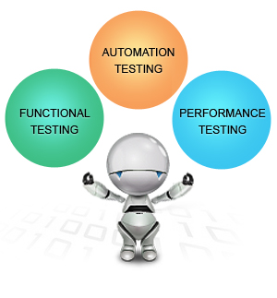
Test scenarios conducted
Test scenarios comprise of the following factors:
Ability to detect the verilog files in a directory correctly
Ability to execute in both Ubuntu and Windows operating environment
Ability to self-run with no user intervention once file is selected
Ability to generate the waveform output successfully
Waveform output is displayed on the GTKWAVE Analyzer
Waveform display on the GTKWAVE Analyser corresponds with the testbench test vectors created

Slide 20
Test scenarios and results
Evaluation Factors | Description | Outcome
1. Cross-platform compatibility | The script implemented should be able to identify the operating environment the script is executing in and execute the segment of the written program code correctly.
2. Listing of verilog files found | The script implemented should be able to correctly list out all the verilog files found within the specified directory.
3. User input validation | If a user enters an index value which exceed the total index value of the listed files found, the script should be able to display an error message to the user and prompt the user to re-enter the index value again.

Slide 21
Test scenarios and results
Evaluation Factors | Description | Outcome
4. Executing of the command line calls | The script should be able to generate the command line calls to invoke the iVerilog tool and simulation runtime engine so that the waveform output can be generated using the GTKWAVE Analyzer.
5. User Intervention | No user intervention is required once the input file is selected.

Slide 22
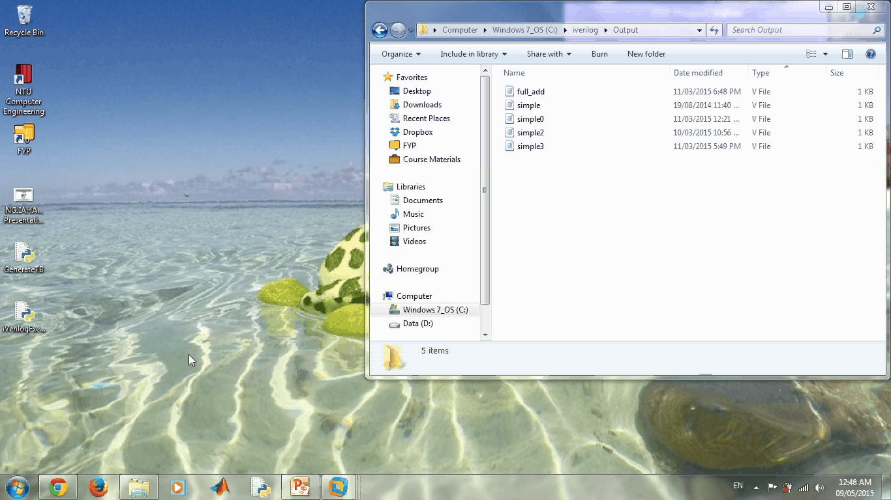
Project Demostration

Slide 23

Future work recommendations
Sequential Logic Implementation
Working with sequential logic designs
Top Module Implementation
Able to create a holistic and complex testbench design
Accepting of test vectors from user
Allowing user to input their own test vectors to test the source design

Slide 24


Challenges & LEARNING Points
Challenges Encountered – Steep learning curve
Unfamiliar with various iVerilog tool execution commands
Designing of algorithms and logics to create testbenches
Integrating the python scripts with the iVerilog tool
Different syntax of executing command line calls in both OS
Unfamiliar with usage of GitHub repository
Learning Points
More familiar with the verilog concepts
Able to apply what was been taught in school into practice
Time Management Skills
Thinking Skills
Troubleshooting Skills

Slide 25

Conclusion
Shown how python scripts can be created and integrated together to automate the process
Using the interface of the iVerilog tool
Objectives and goals of the project have been met successfully
Generate a robust testbench from a given input verilog file

Slide 26

Acknowledgements
Assistant Professor Fahmy for his invaluable advices throughout the entire project
His fellow course mates for their encouragement
Laboratory staffs for their logistical support and kind assistance on technical issues
Dr Newton Fernando for taking his time to read and access this project

Slide 27

Any Questions?

